Slide 1

SOLAR POWER PLANT DESIGN
Introduction

Slide 2
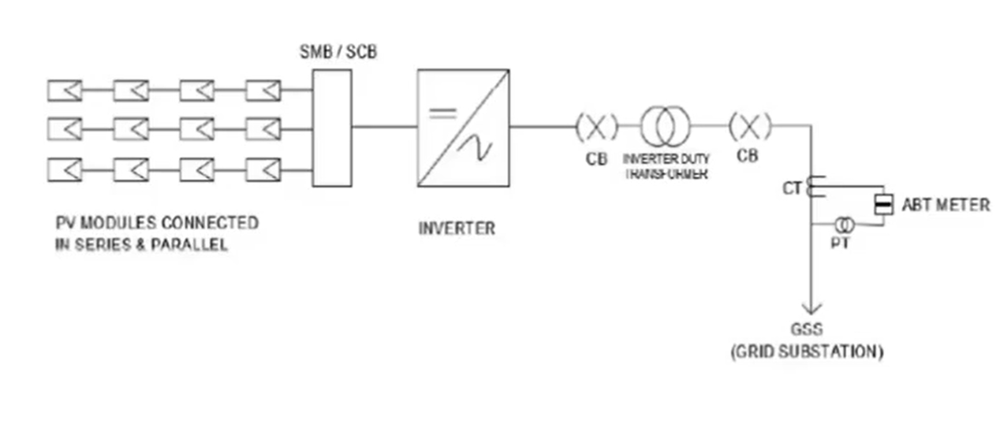
Grid Connected solar power plant

Slide 3
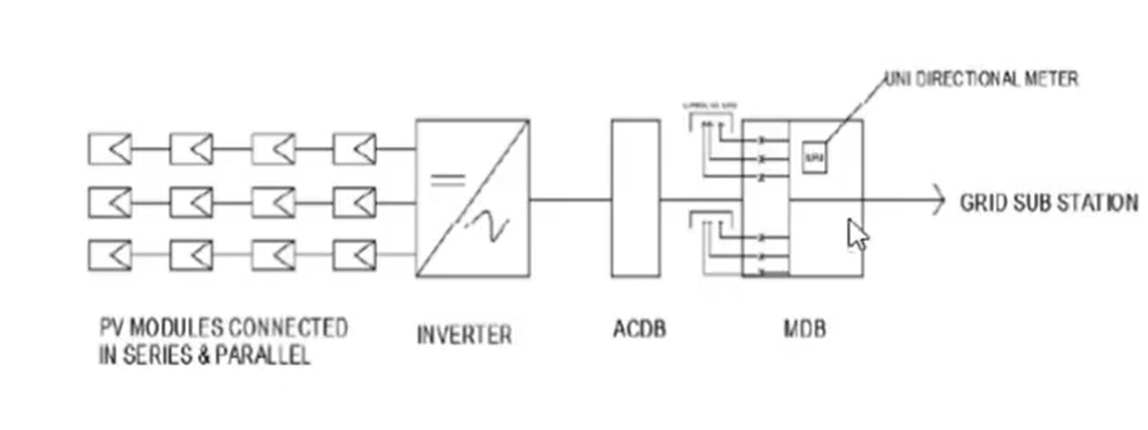
Grid interactive solar power plant

Slide 4
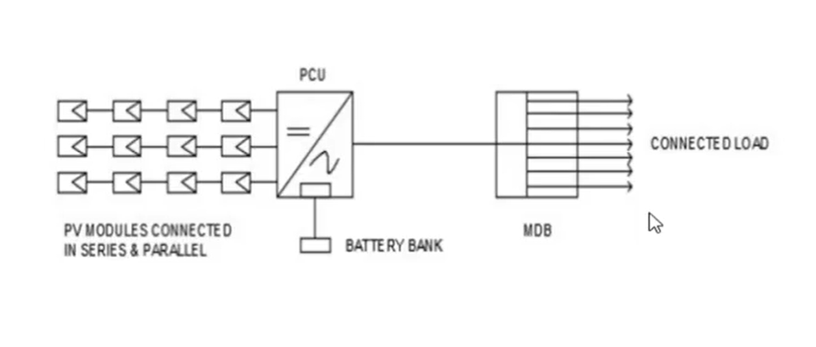
Off – grid solar power plant

Slide 5
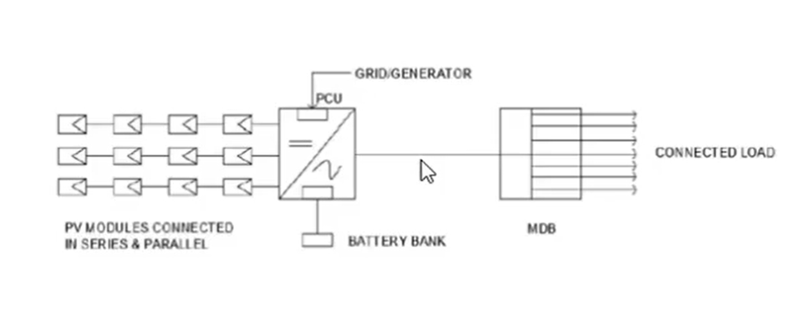
Hybrid solar power plant

Slide 6
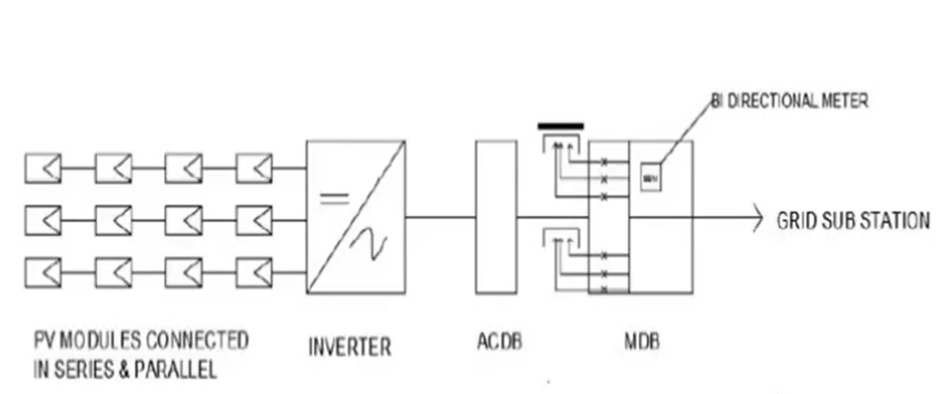
Net & gross metering system

Slide 7

Ground mounted solar plant

Slide 8

Rooftop solar plant

Slide 9
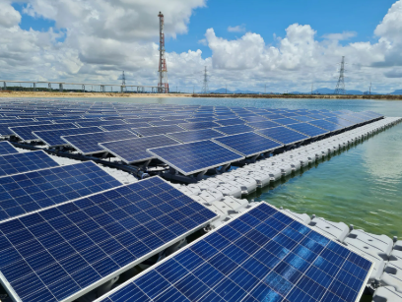
Floating Solar plant

Slide 10
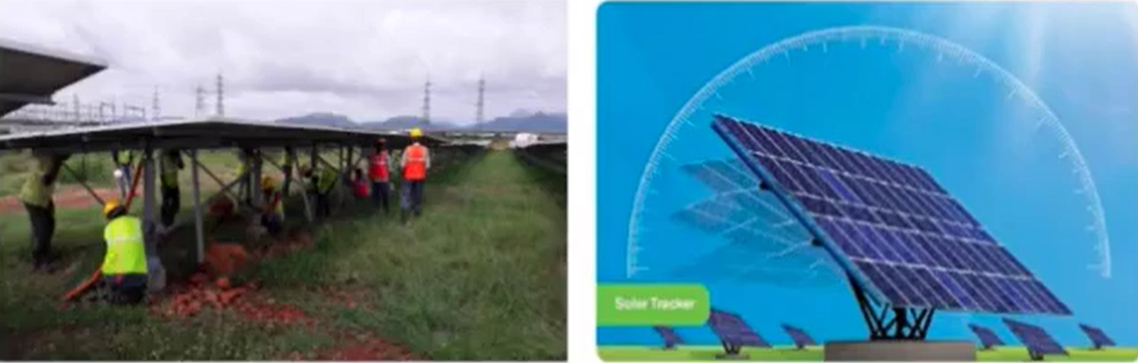
Fixed tilt / seasona tilt & tracker system

Slide 11
State Policy-RAJASTHAN
Connectivity of rooftop pv power solar plant
Eligible consumer & individual Project capacity
Interconnection with grid (safety & standards)

Slide 12
Connectivity level based on Project capacity
SI. NO | Connected load of eligible consumer | Connectivity level
1 | Up to 5 KW | 240V Single phase
2 | Above 5 KW & up to 18.65 KW | 415V —Three phase
3 | Above 18.65 KW up to 50 KW/KVA | 415V-Three phase
4 | Above 50 KW,KVA | HT,EHT level

Slide 13
Project Financing-Model
Capex
Opex
PPA

Slide 14
Project Financing-Model
Capex
Opex
PPA
Capital Expenditure

Slide 15
Project Financing-Model
Capex
Opex
PPA
Operational Expenditure

Slide 16
Project Financing-Model
Capex
Opex
PPA
Power Purchase Aggrement

Slide 17
Thank you

